Slide 1

Euro2020
project
by Igor Zelenov

Slide 2
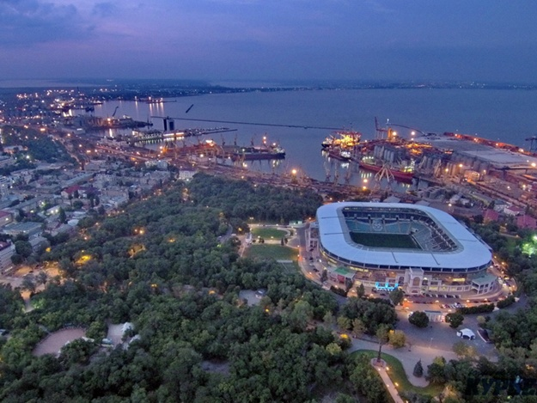
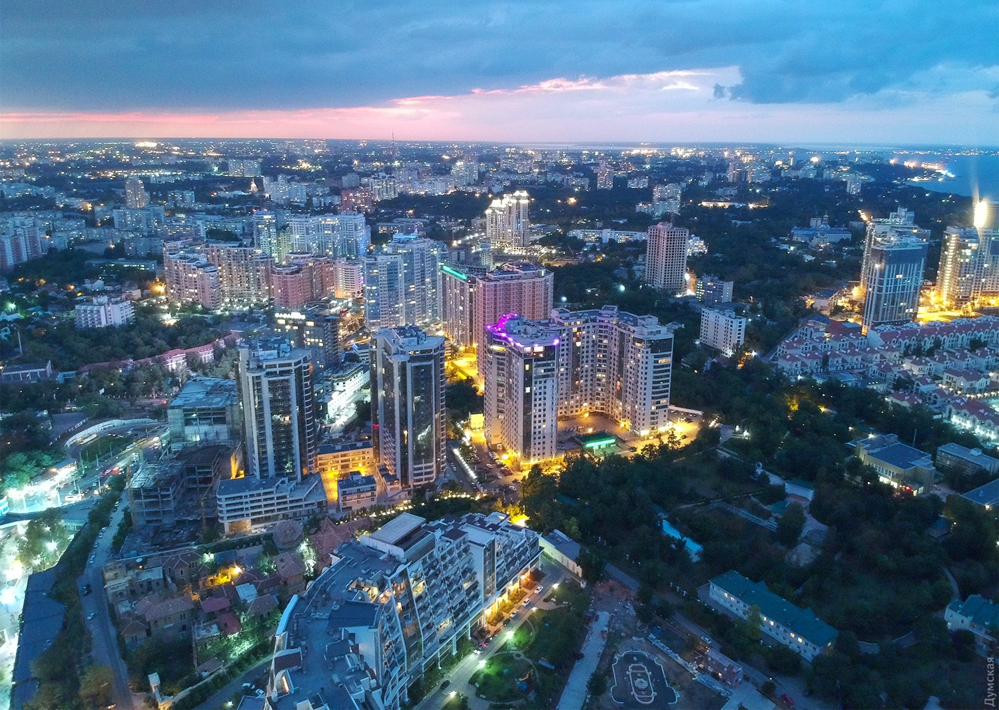
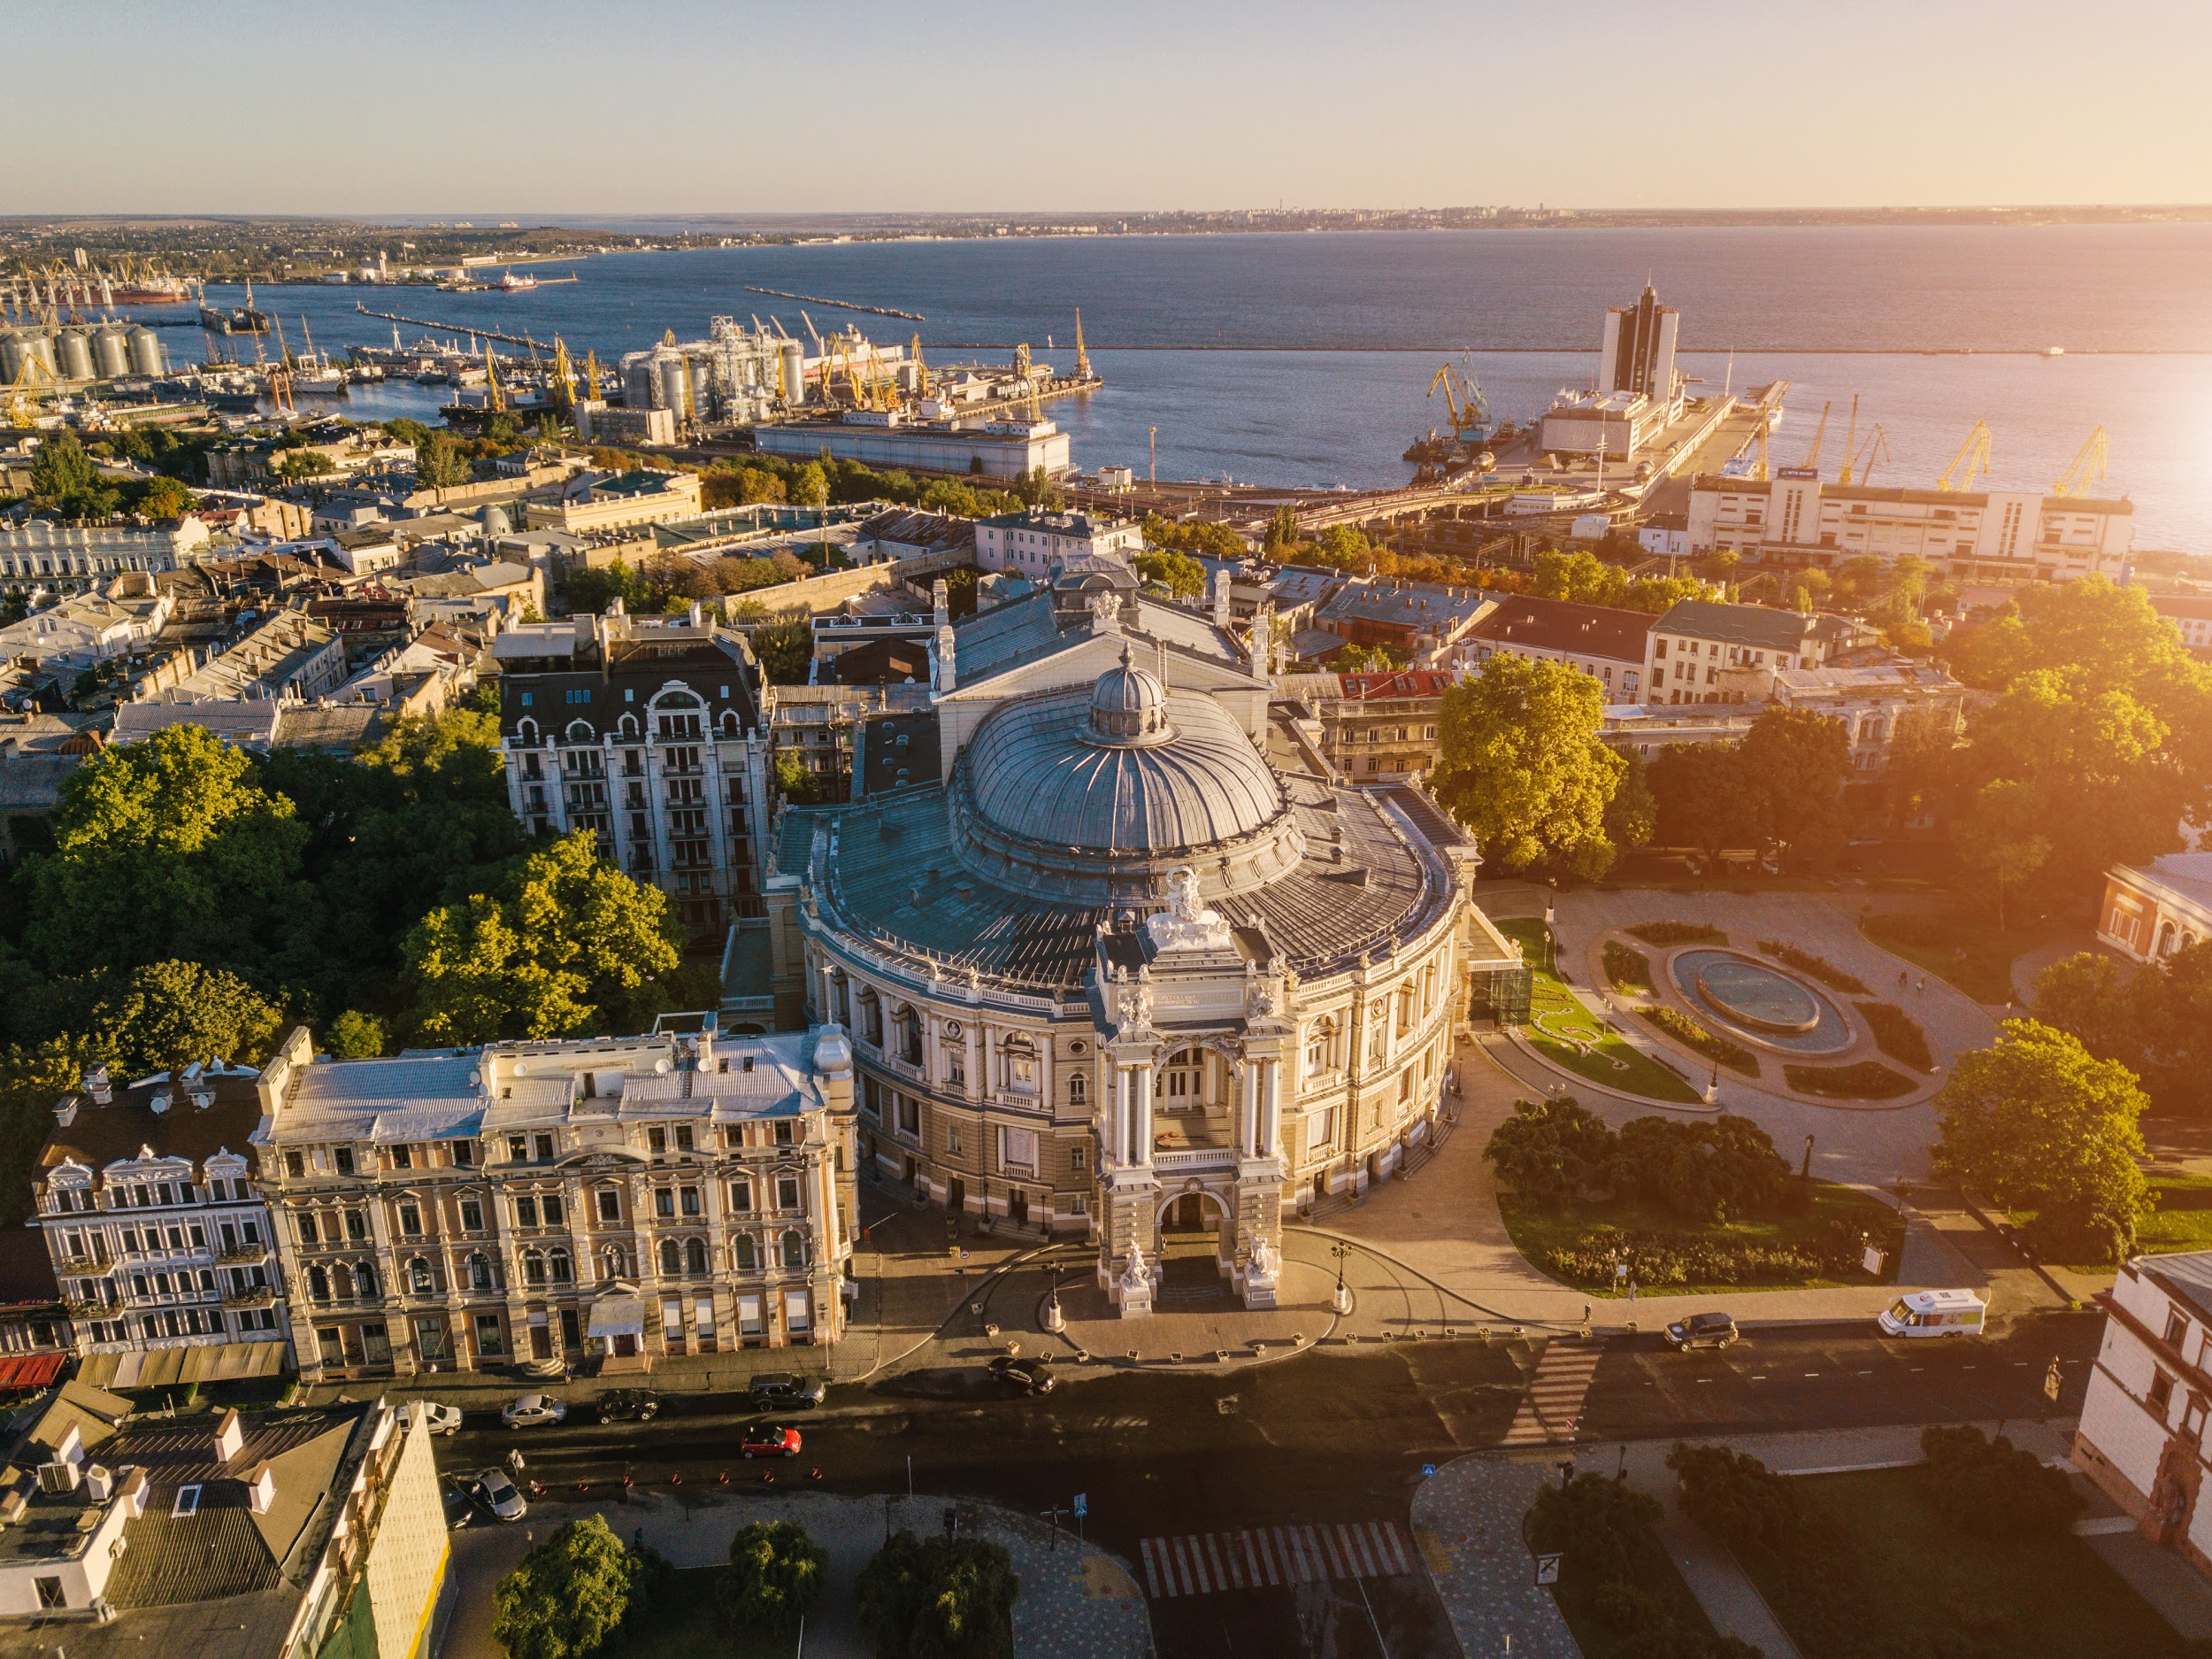
Odessa, Ukraine

Slide 3

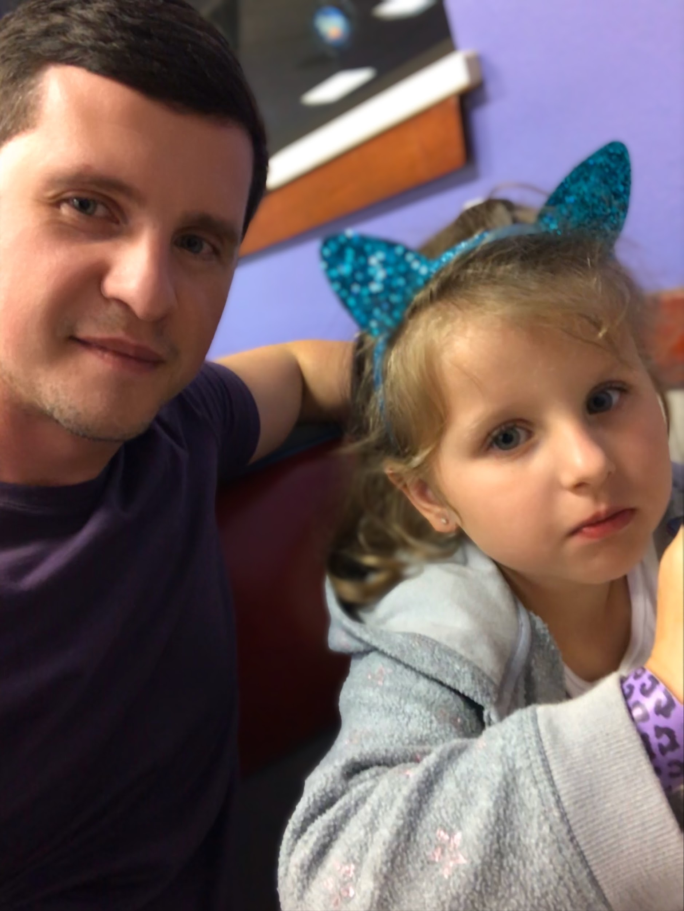
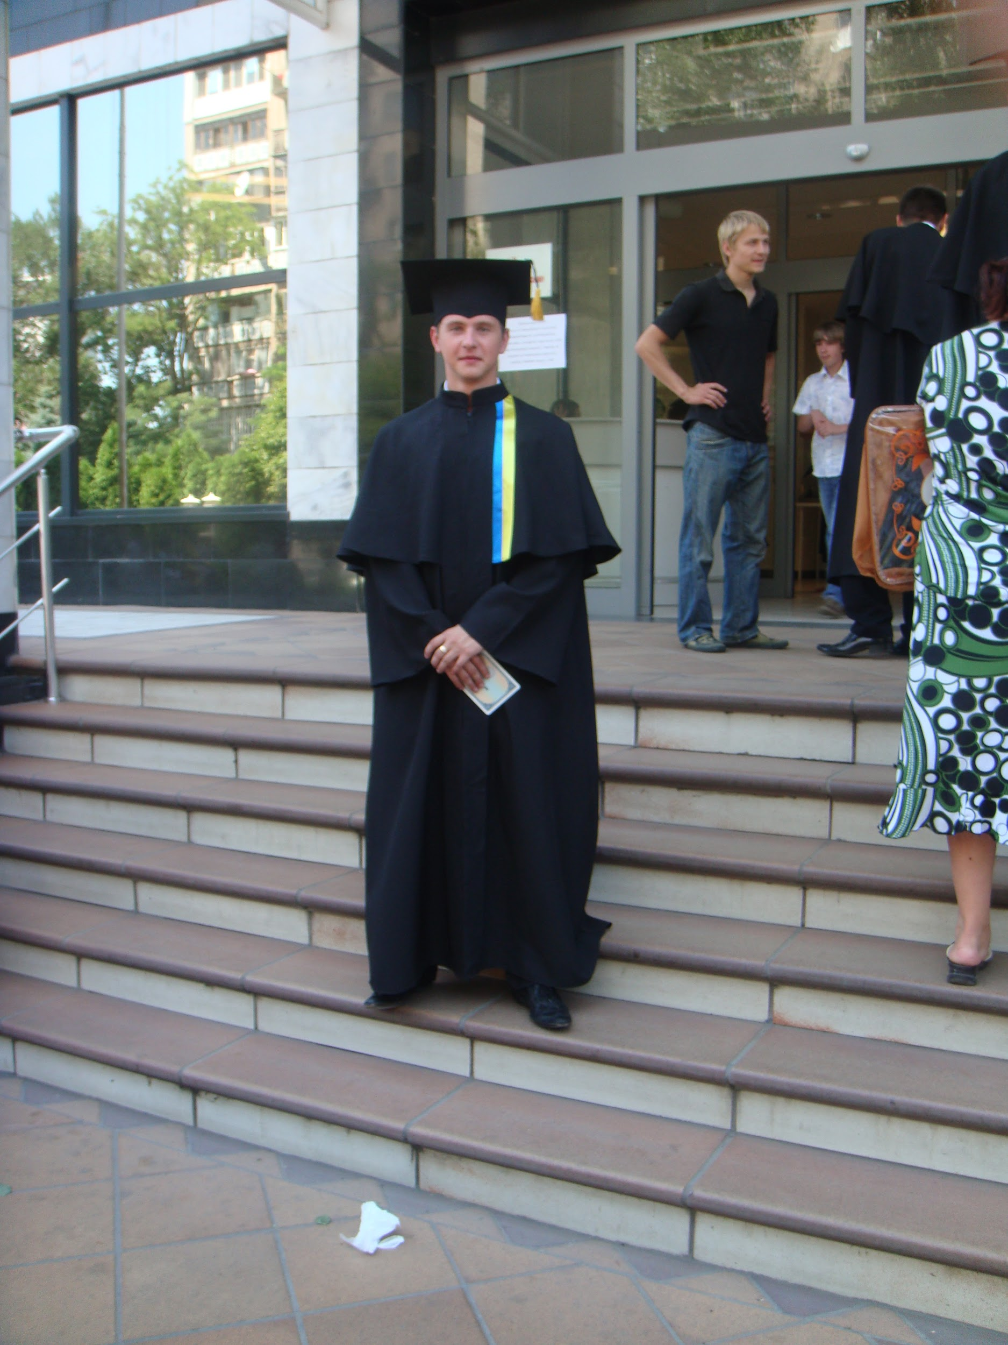
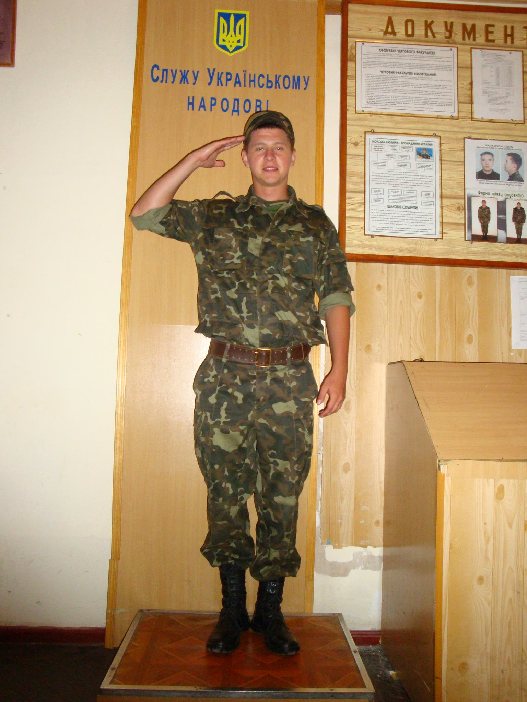
Some facts about me

Slide 4

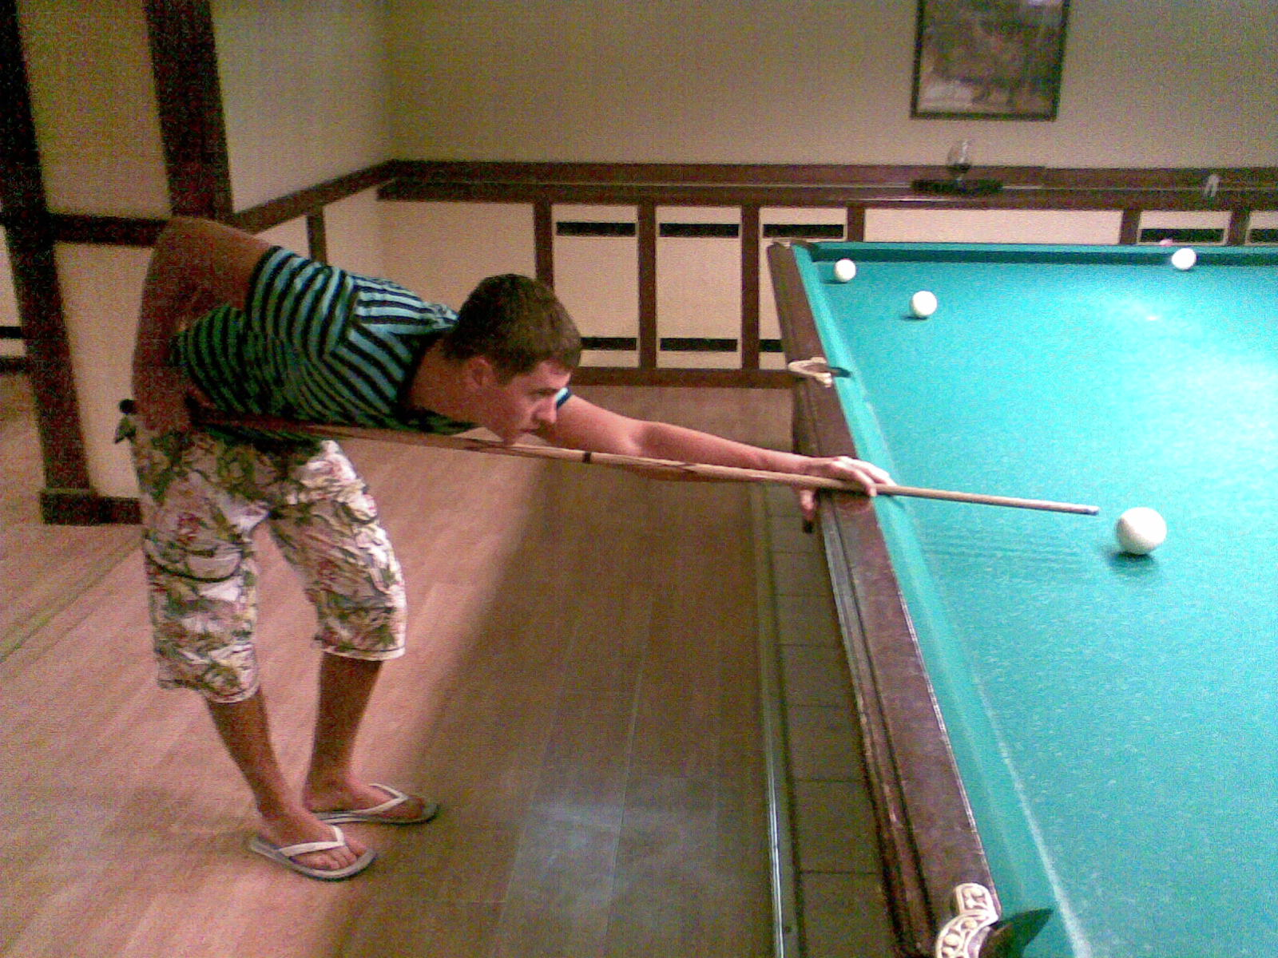
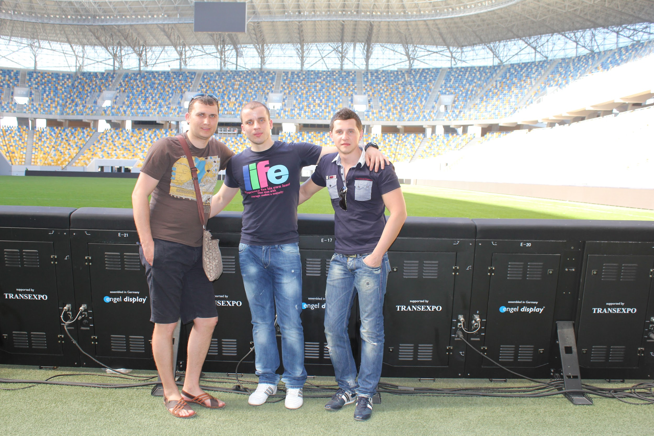

Slide 5
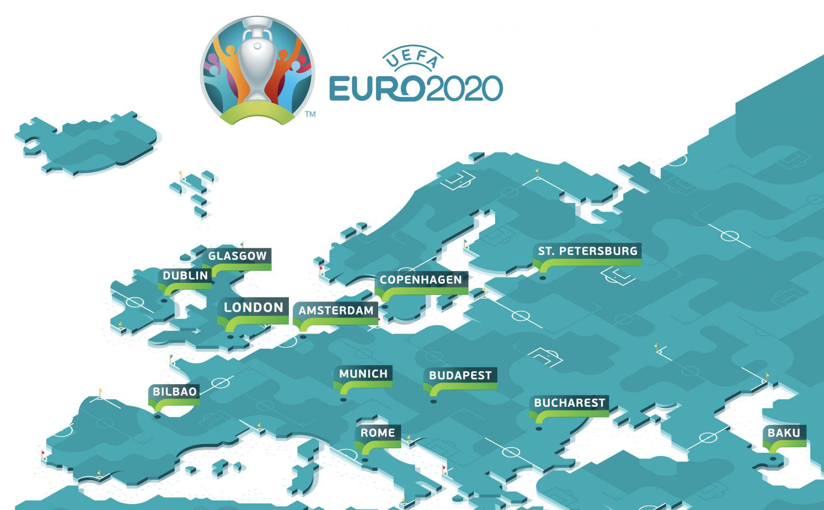

Slide 6
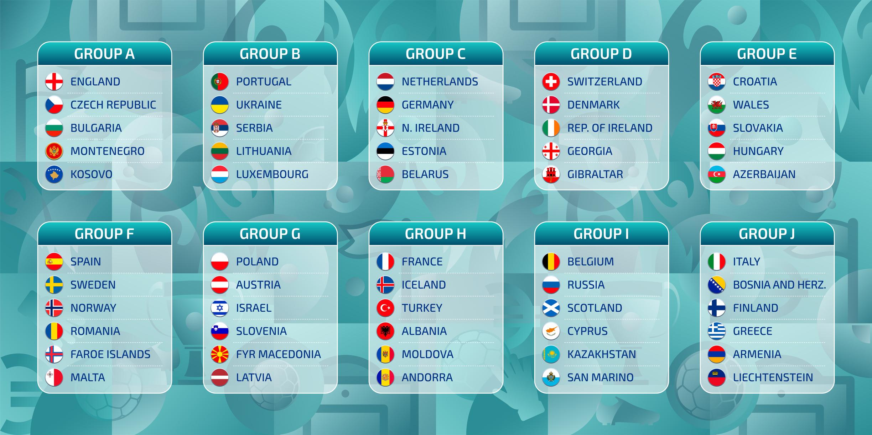

Slide 7
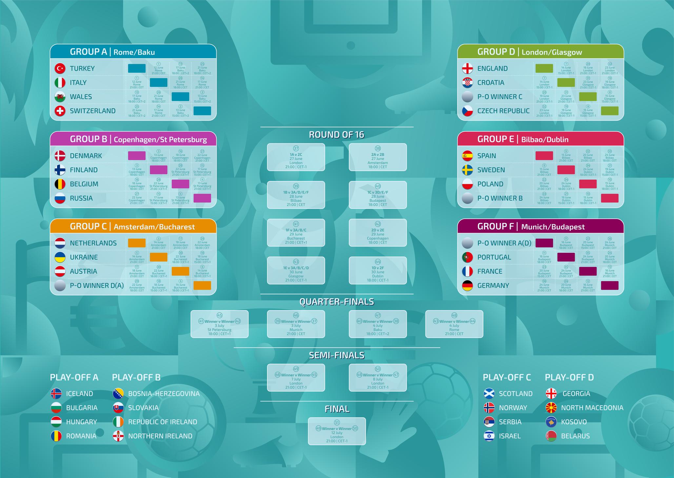

Slide 8
Technical challenge:
looking for API with decent data
checking and getting all necessary data from API servers
minor coding issues during creating the application

Slide 9

The biggest mistake:
spend a lot of time for searching API

Slide 10

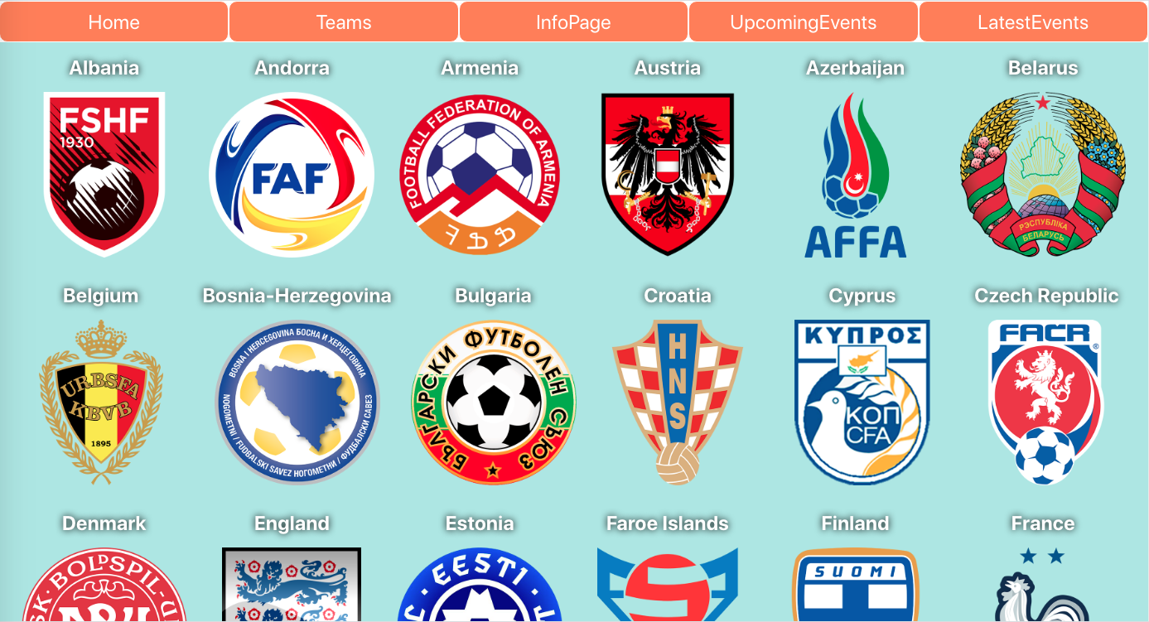
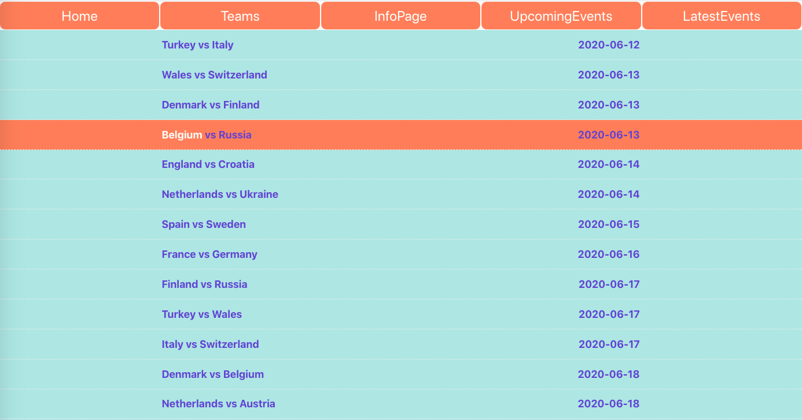
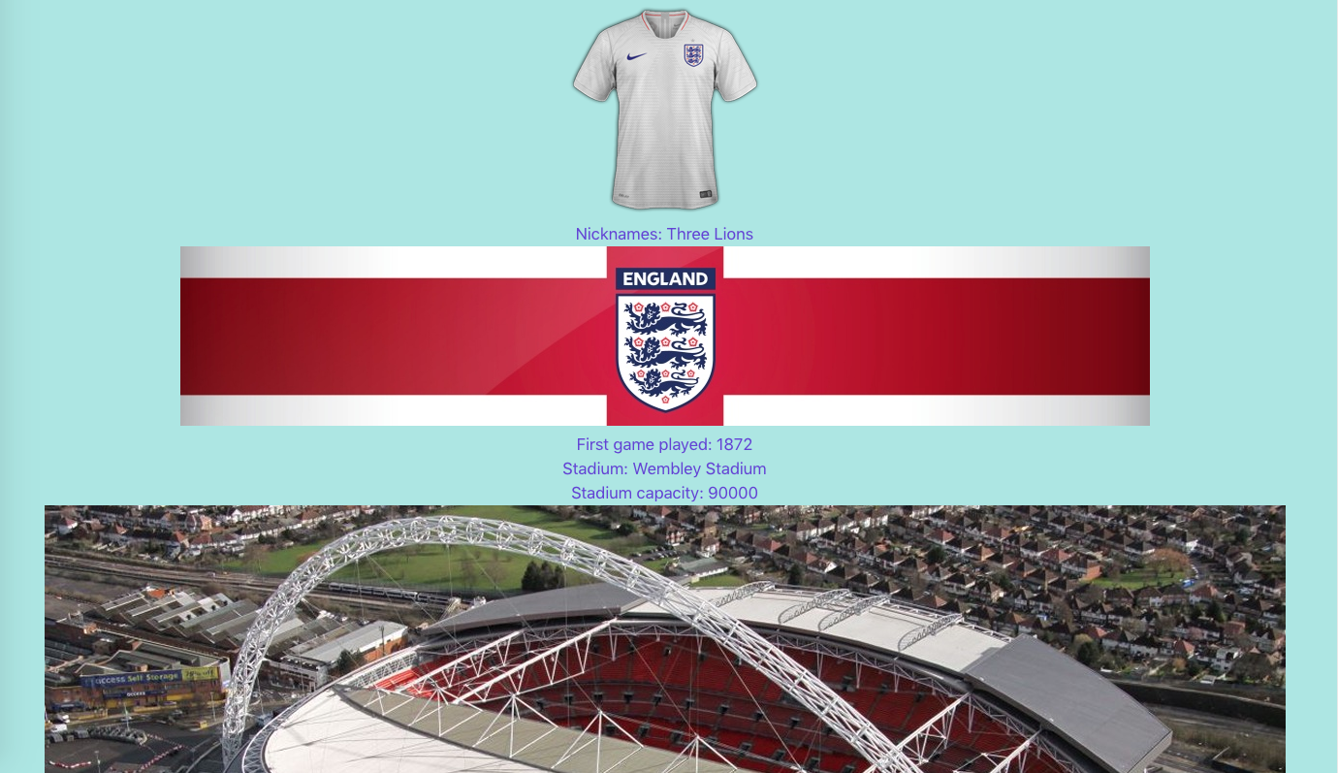
Demo

Slide 11

Euro2020project
by Igor Zelenov
https://uefaeuro2020.netlify.com
Thank you for attention

